Slide 1
Learn How to Automate with VMware PowerCLI
2118
Russell Hamker
VMware Enterprise Architect
#vmwareexplore #PowerCLI

Slide 2
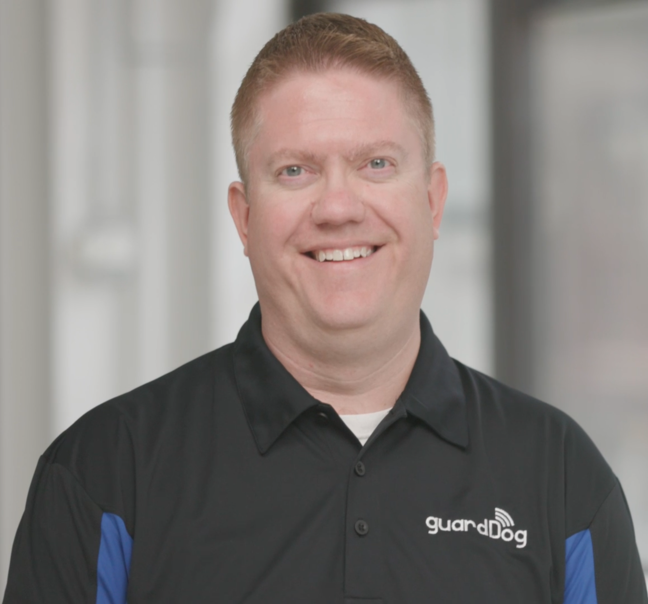

Intro
Learn How to Automate with VMware PowerCLI
About Me:
Russell Hamker
15+ years Running VMware
VCAP-2022, VCP-DCV 5-2022, VCP-VMC 2023
Employer – Guard Dog Solutions Inc
Title – VMware Enterprise Architect
vExpert – 8 years and running
VMUG Leader – Wichita KS
Twitter - @butch7903
Tanzu Vanguard

Slide 3
VMware PowerCLI Hero’s
PowerShell Basics
Variables
Install PowerCLI
Importing Modules
Demo connecting to a VCSA
Examples
Importance of GitHub/Visual Studio

Slide 4



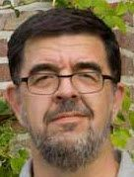

VMware PowerCLI Hero’s
William Lam
Senior Staff Solution Architect
@lamw
Alan Renouf
Advanced Projects Lead at VMware
@alanrenouf
Cormac Hogan
Chief Technologist at VMware
@CormacJHogan
Luc Dekens
vExpert 2009-2022/ Co-author VMware vSphere PowerCLI @LucD22
Vladan Seget
Founder and Executive Editor of ESX Virtualization Blog
@vladan

Slide 5
PowerShell Basics

Slide 6
Info
PowerShell is an object-oriented programming language invented by Jeffrey Snover at Microsoft.
It is a cross-platform (Windows, Linux, and macOS) automation and configuration tool/framework that works well with your existing tools and is optimized for dealing with structured data (e.g. JSON, CSV, XML, etc.), REST APIs, and object models. It includes a command-line shell, an associated scripting language and a framework for processing cmdlets.
VMware took great interest as vCenter used to run on Windows
PowerShell converts API calls to cmdlets (commandlets)
PowerShell modules are a set of cmdlets that allow you to do things

Slide 7
Types of Commands
Examples:
Get
Set
Remove
Restart
Import/Export
Clear

Slide 8
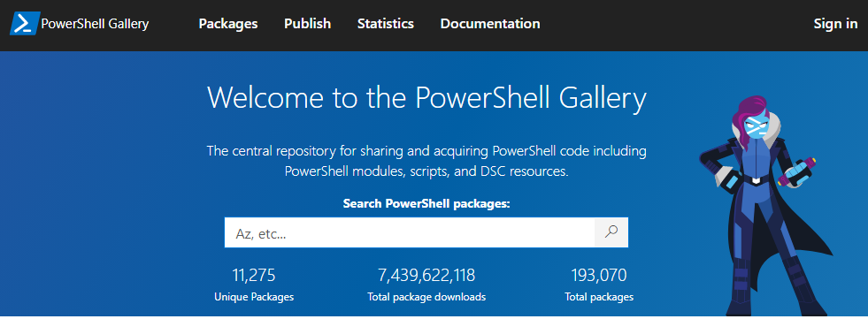
PowerShell Gallery
The Site to get most PowerShell Modules:
https://www.powershellgallery.com

Slide 9
File Types
Different File Types for PowerShell
Powershell Scripts (*.ps1)
Powershell Modules (*.psm1)
Powershell Data Files (*.psd1)
Powershell Session Configuration Files (*.pssc)
Powershell Role Capability Files (*.psrc)
Powershell Xml Files (*.psxml, *.cdxml)

Slide 10
Cmdlet Parameters
AKA Flags
Get-VMHost [[-Name] <String[]>] [-Datastore <StorageResource[]>] [-Location <VIContainer[]>] [-NoRecursion]
[-Server <VIServer[]>] [-State <VMHostState[]>] [-Tag <Tag[]>] [<CommonParameters>]
Get-VMHost [[-Name] <String[]>] [-Datastore <StorageResource[]>] [-Location <VIContainer[]>] [-NoRecursion]
[-ResourcePool <ResourcePool[]>] [-Server <VIServer[]>] [-Tag <Tag[]>] [-VM <VirtualMachine[]>]
[<CommonParameters>]

Slide 11
Variables

Slide 12
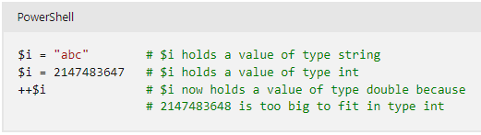
Variables - Info
A variable is a unit of memory in which values are stored.
In PowerShell, variables are represented by text strings that begin with a dollar sign ($), such as $a, $process, or $my_var.
A variable represents a storage location for a value, and that value has a type.

Slide 13
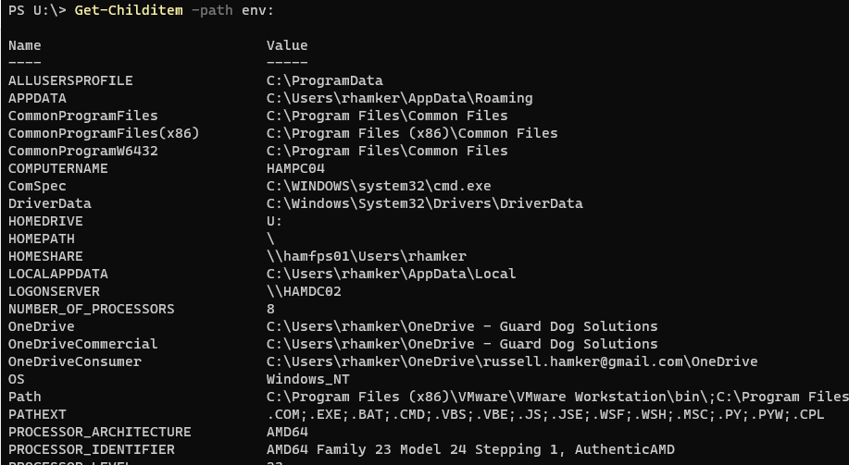
Environment Variables
Environment variables store data that's used by the operating system and other programs.
Get-Childitem –path env:

Slide 14
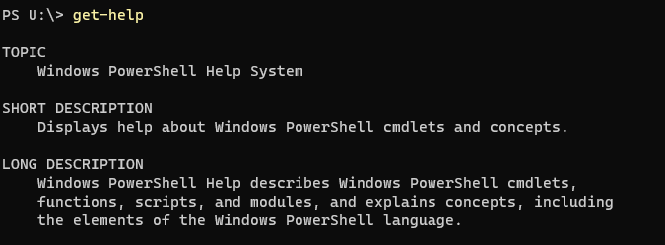
Get-Help
Displays information about PowerShell commands and concepts.

Slide 15
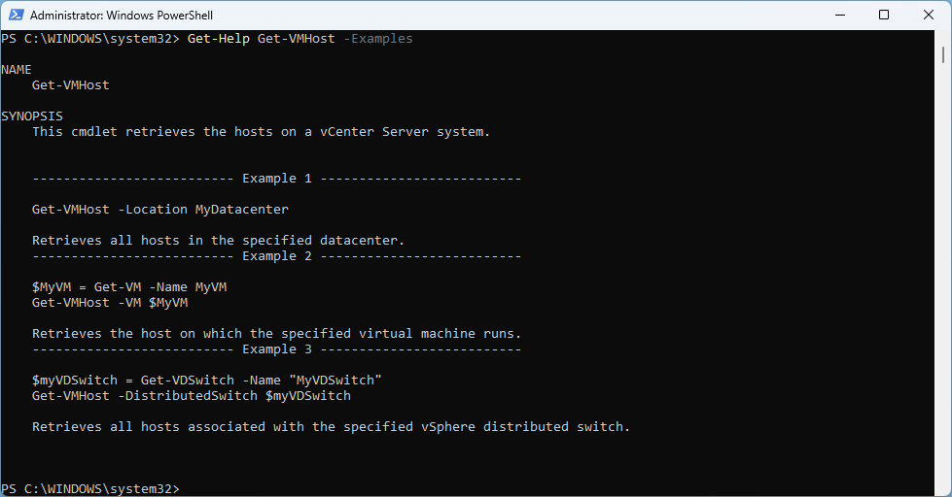
Get-Help with Examples
Most Get-Help areas for a PowerShell Cmdlet include examples of how to run the command.

Slide 16
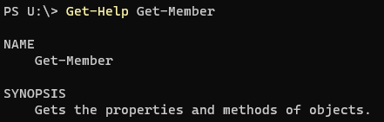
Get-Member
Gets the properties and methods of PowerShell objects

Slide 17
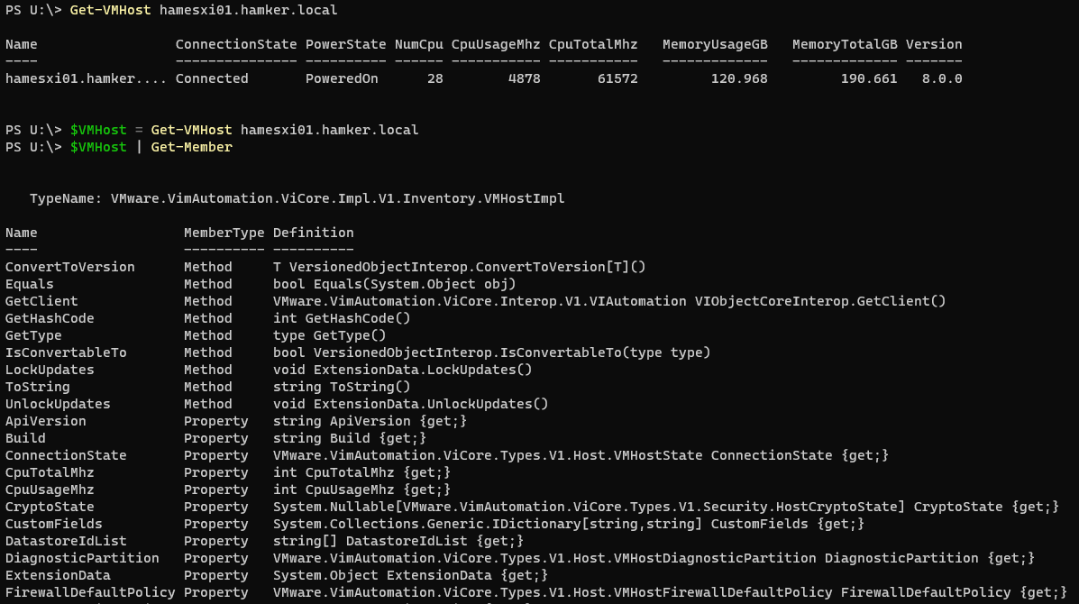
Get-Member Example
$VMHost | Get-Member

Slide 18
Install PowerCLI

Slide 19
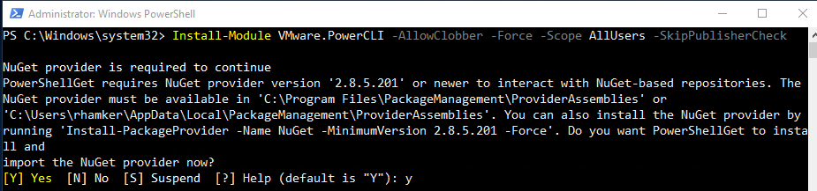
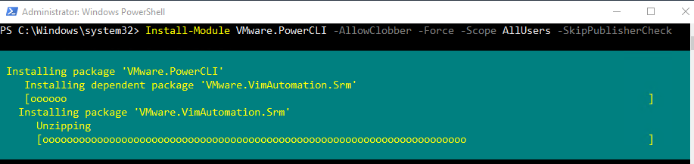
How to Install
Open PowerShell with Admin Rights (Computer must have Internet Access to Download)
Command To Install:
Install-Module VMware.PowerCLI -AllowClobber -Force -Scope AllUsers –SkipPublisherCheck
Y to install NuGet

Slide 20
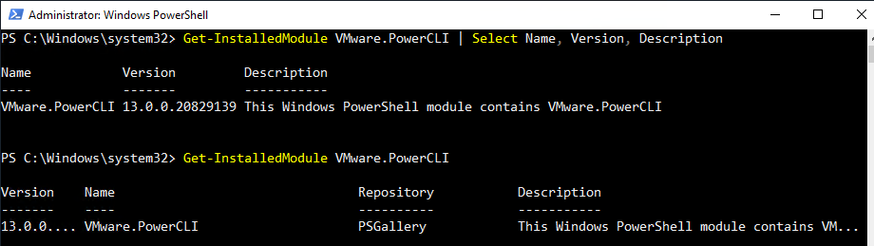
Validate PowerCLI Installation
Open PowerShell (Admin rights are NOT required after PowerCLI is installed)
Command To Validate:
Get-InstalledModule VMware.PowerCLI | Select Name, Version, Description

Slide 21
Python is Required for PowerCLI?
A New requirement for PowerCLI is that it also requires Python be installed for the VMware.PowerCLI.ImageBuilder
https://vdc-repo.vmware.com/vmwb-repository/dcr-public/9619cb6d-3975-4bff-aa1f-0e785283a1a9/58d0925b-e15d-4803-bbd4-eb314dd165b0/GUID-9081EBAF-BF85-48B1-82A0-D1C49F3FF1E8.html

Slide 22
Setting the Python Settings for PowerCLI
Set Python Settings for PowerCLI (Do this as Admin)
Set-PowerCLIConfiguration -PythonPath "C:\Program Files\Python\python.exe" -Scope AllUsers

Slide 23
Uninstalling a PowerShell Module
Open PowerShell (Do this as Admin)
Uninstall-Module VMware.Powercli

Slide 24
Importing Modules

Slide 25
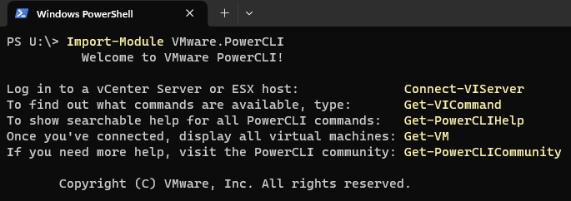
Importing a PowerShell Module
Open PowerShell (Admin rights are NOT required after PowerCLI is installed)
Command To Import:
Import-Module VMware.PowerCLI
Note: This command takes a while to run, as it loads all the PowerCLI Sub Modules into memory.

Slide 26
Auto Importing a PowerShell Module
Interactive only usage
The `Import-Module` cmdlet adds one or more modules to the current session. Starting in PowerShell 3.0, installed modules are automatically imported to the session when you use any commands or providers in the module. However, you can still use the `Import-Module` command to import a module.
When Doing Automation (PS1 files), you must specify import-module in your code.

Slide 27
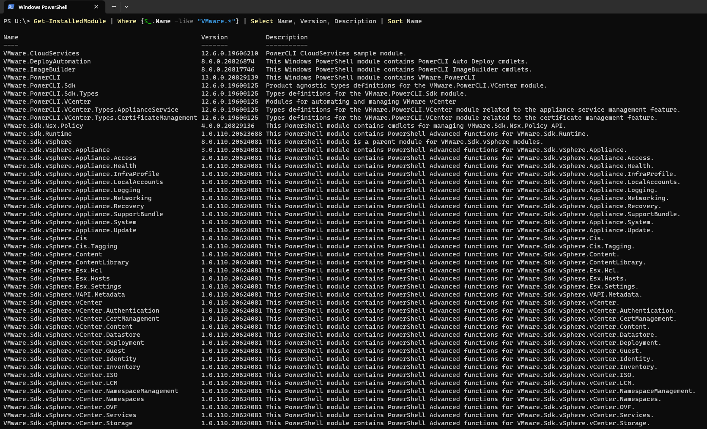
Importing Modules that you Need
To Speed up Automation, only Import the specific VMware PowerCLI Module you need.

Slide 28
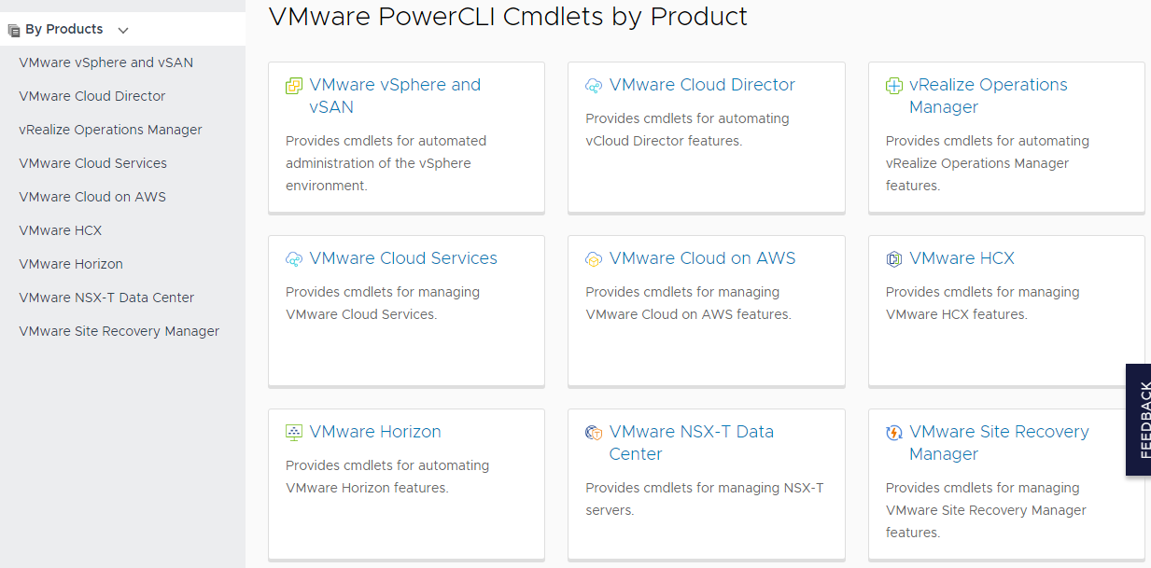
How many PowerCLI Cmdlets are there?
https://developer.vmware.com/docs/powercli/latest/products/

Slide 29
Demo connecting to a VCSA

Slide 30
Commands
Import-Module VMware.PowerCLI
$vcsa = "hamvc01.hamker.local"
$creds = Get-Credential
Connect-VIServer $vcsa -credential $creds

Slide 31
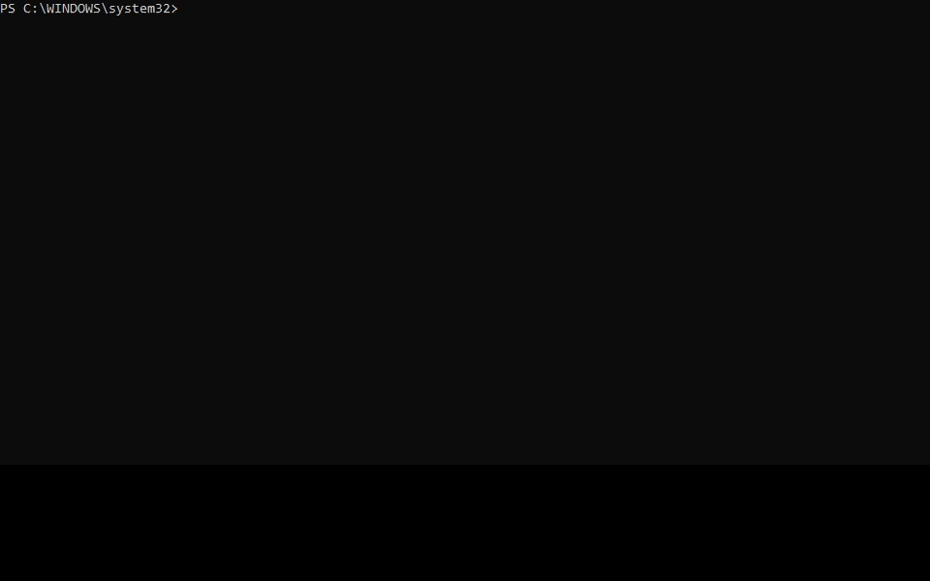

Slide 32
Examples/Demo

Slide 33
Commands
Get List of Hosts
Get-VMHost
Get-VMHost | Sort Name
(Get-VMHost).count
Get-VMHost -Name hamesxi01*
$vmhost = Get-VMHost -Name hamesxi01*
$vmhost | select *
$vmhostinfo = $vmhost | select Name, Model, Version, Build
$vmhostinfo

Slide 34
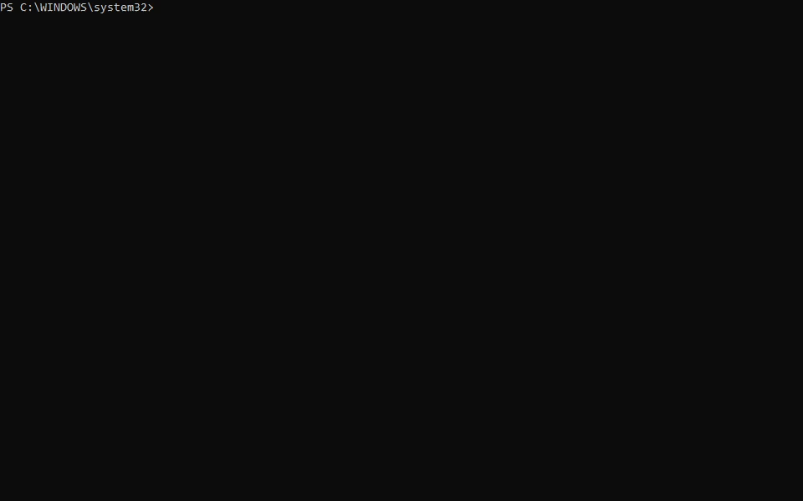

Slide 35
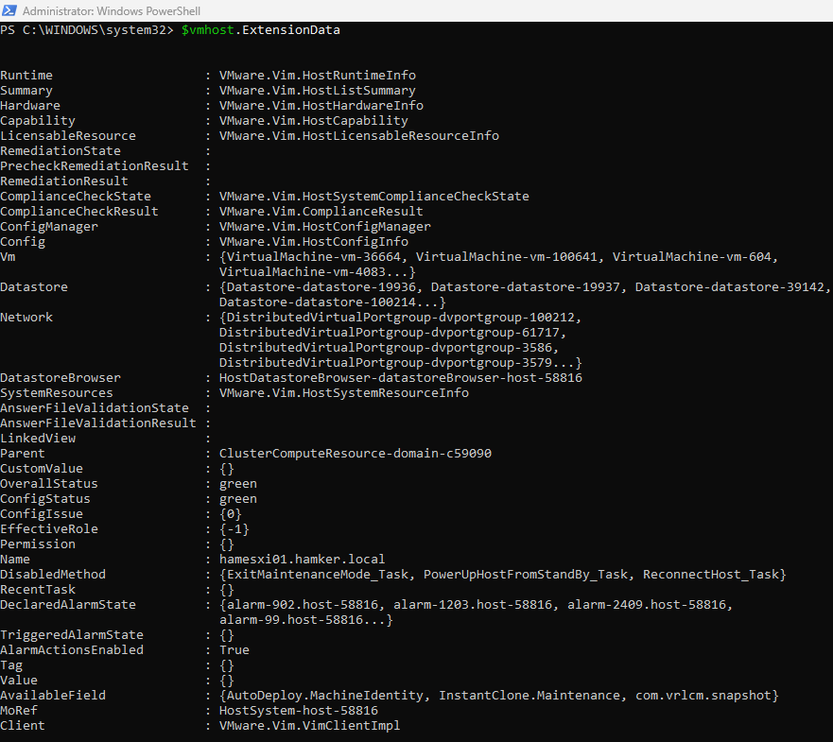
Commands
ExtensionData
$vmhost.ExtensionData

Slide 36
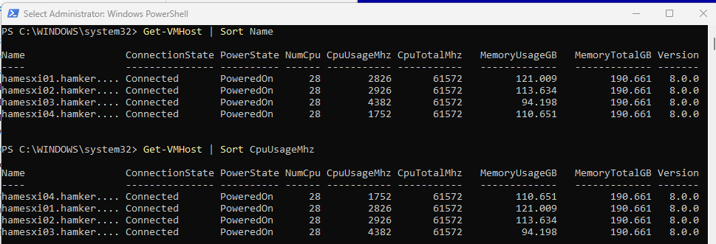
Commands
Sorting Examples
Get-VMHost | Sort Name
Get-VMHost | Sort CpuUsageMhz

Slide 37
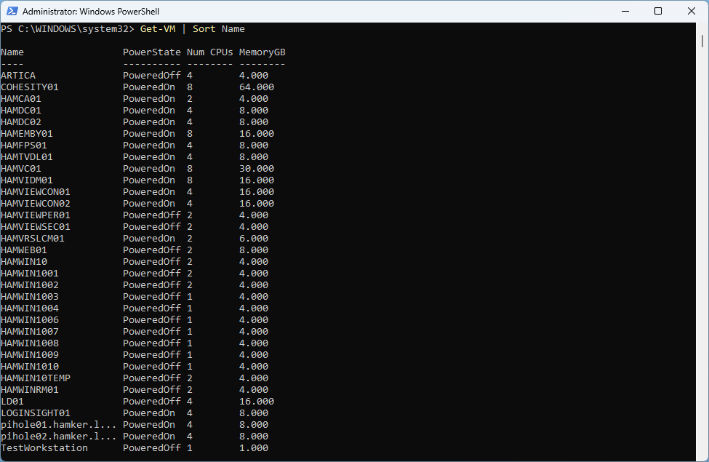
Commands
List All VMs
Get-VM | Sort Name

Slide 38
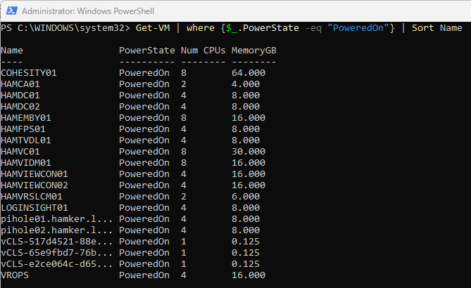
Commands
List All VMs that are Powered On
Get-VM | where {$_.PowerState -eq "PoweredOn"} | Sort Name

Slide 39
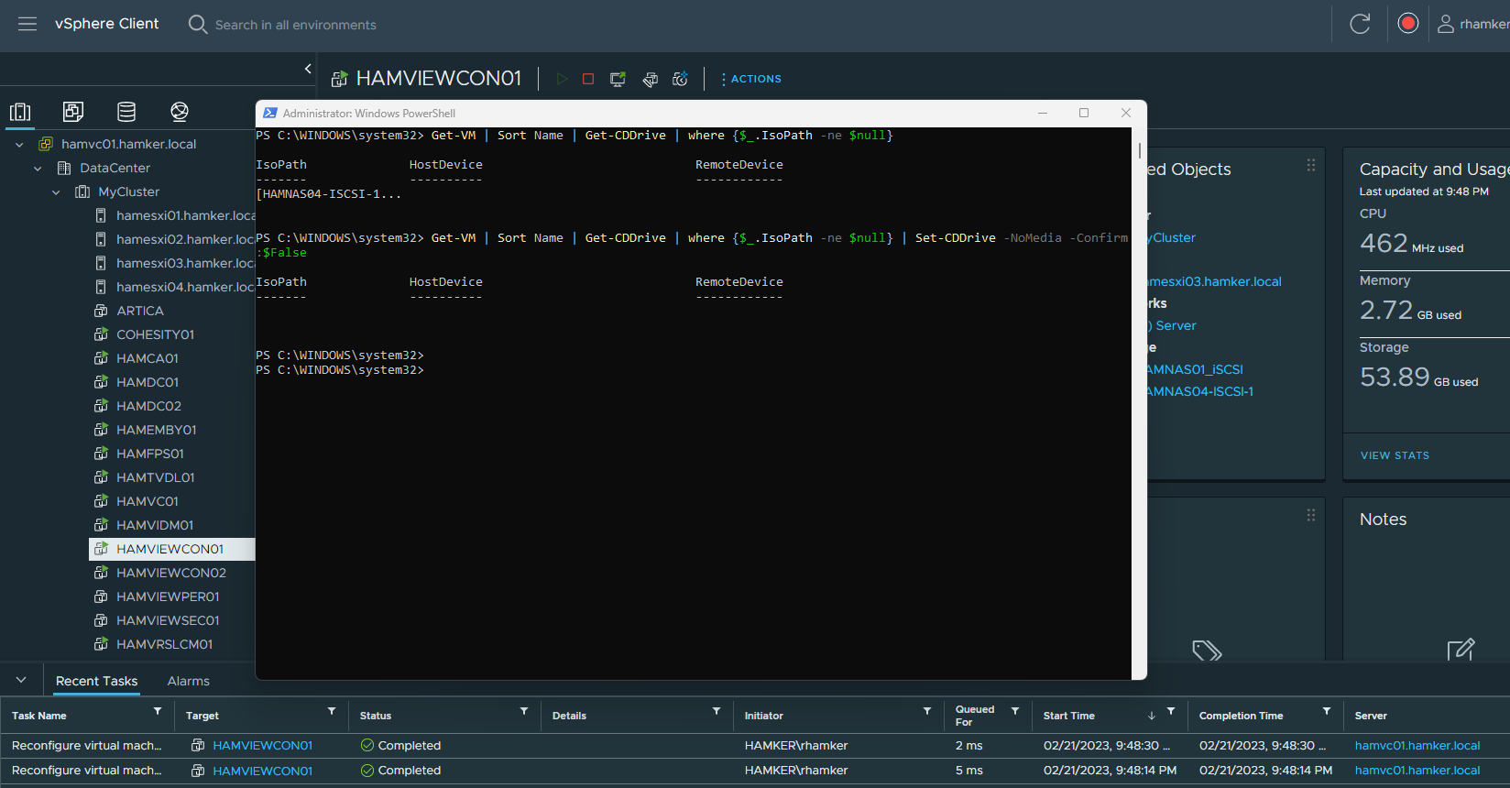
Commands - Unmount ISOs from all VMs – Useful before ESXi Upgrades
Get-VM | Sort Name | Get-CDDrive | where {$_.IsoPath -ne $null}
Get-VM | Sort Name | Get-CDDrive | where {$_.IsoPath -ne $null} | Set-CDDrive -NoMedia -Confirm:$False

Slide 40
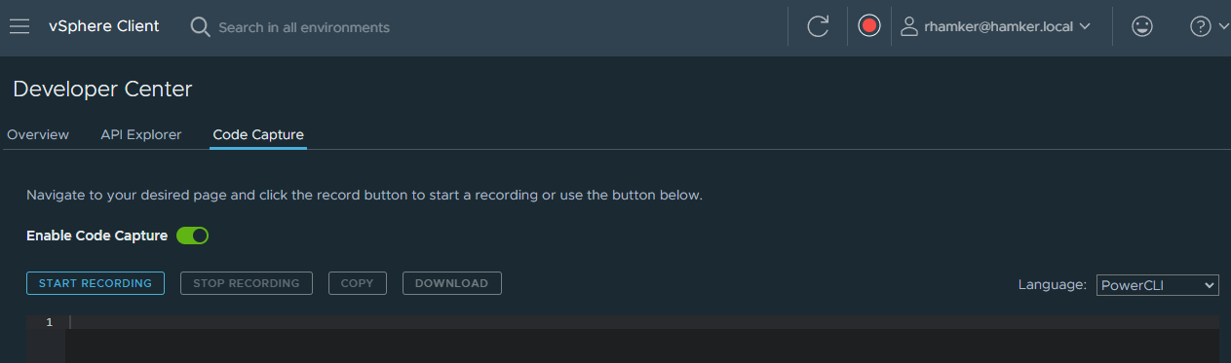
vSphere Code Capture
Code Capture records user actions and translates them into executable code.
Code Capture gives you the ability to record actions taken in the vSphere Client and output them as usable PowerCLI code. You can then copy the code or download it as a script and use it in a PowerShell session to execute the task.

Slide 41
Importance of GitHub/Visual Studio

Slide 42
GitHub/GitLab for PowerShell
How Git works
Git is a managed, distributed database that tracks a group of files as they change. A contained group of files is called a repository. Each change, which can affect multiple files at a time, is called a commit and requires admins to save by committing, or instating, those changes.
To back up changes, you push changes to a central Git server or service. If someone else has made changes, you can pull those changes into a local copy of the repository.
If multiple people or teams work within the same repository, each can maintain their own copies of the files in the repository with a branch.
Reference: https://www.techtarget.com/searchitoperations/tutorial/How-to-use-Git-to-save-PowerShell-scripts

Slide 43
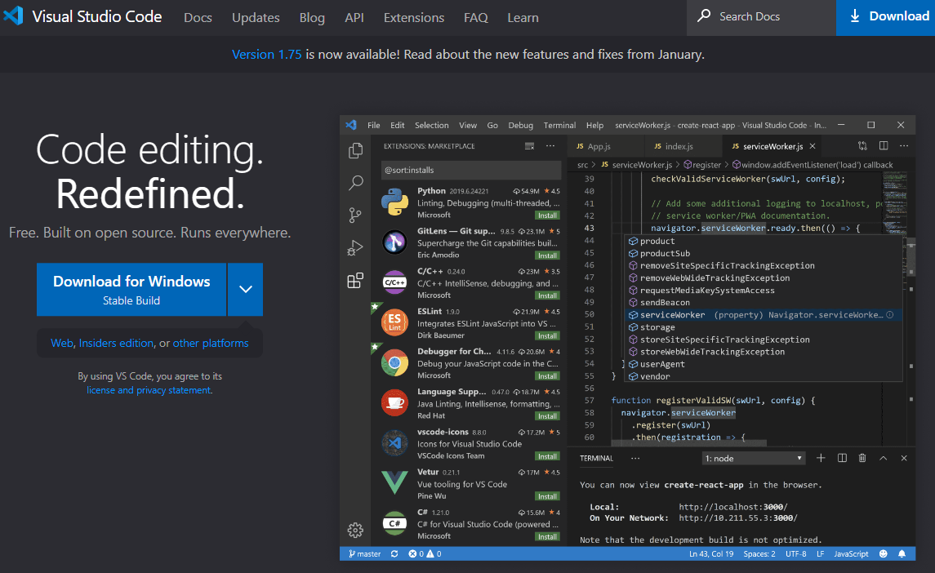
Visual Studio Code

Slide 44
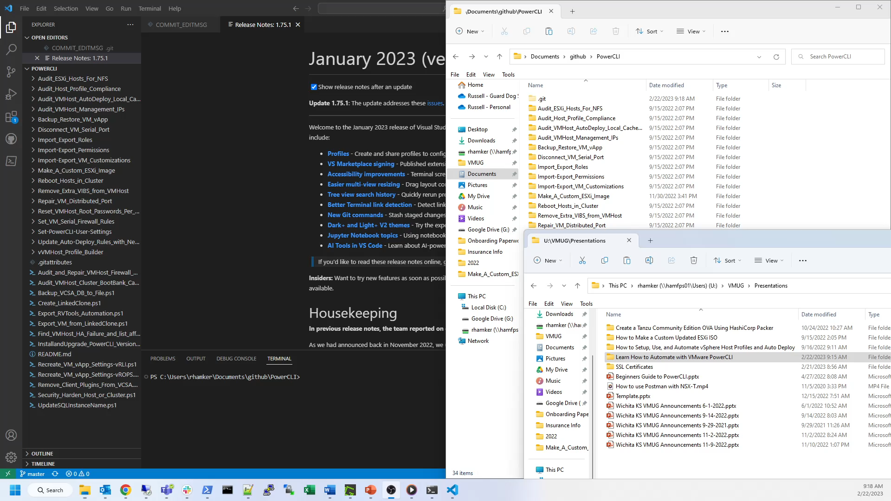
Example GitHub Code Commit

Slide 45
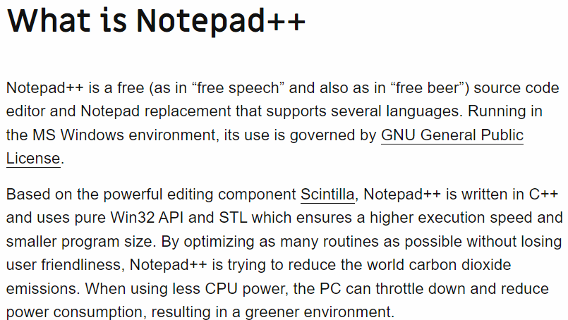
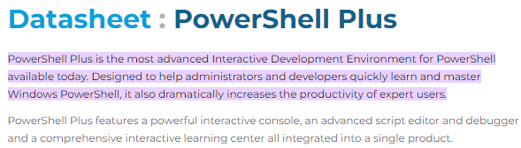
Other good Editors
Made by IDERA

Slide 46
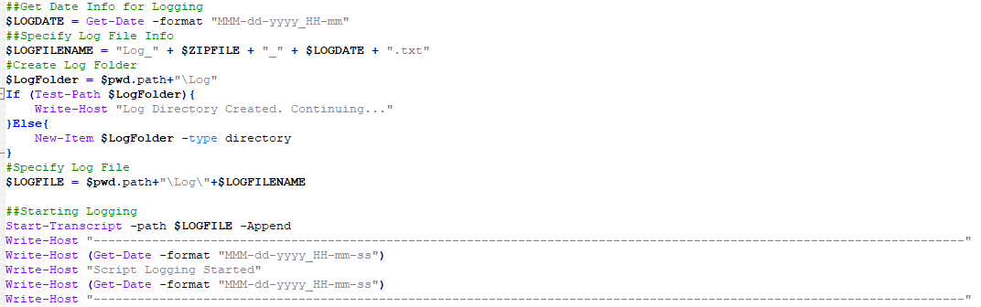
Logging Your Code
Log your code output to help with better troubleshooting. This is especially useful for automation.

Slide 47

Make your Code Cookie Cutter
Template your Code!

Slide 48
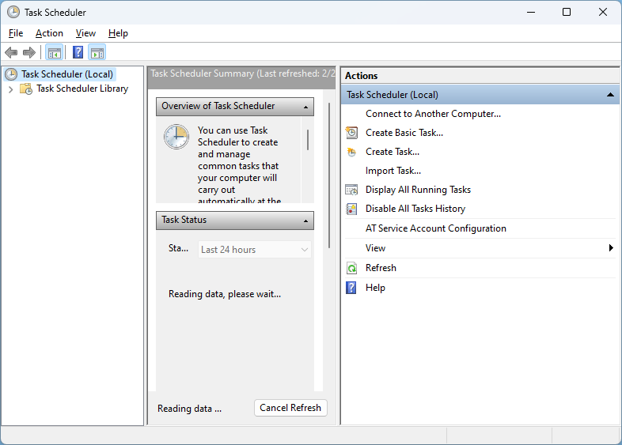
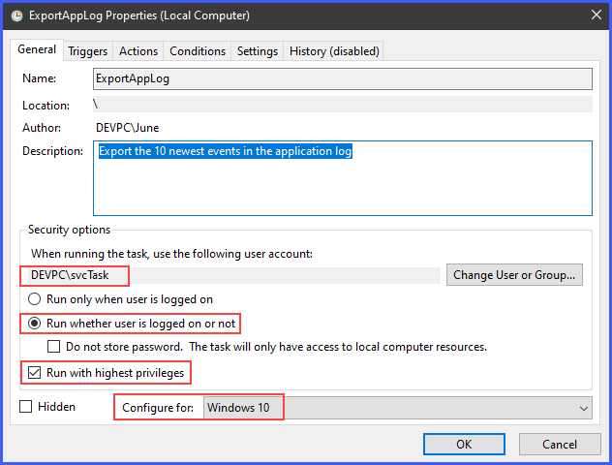
How do I Run PowerShell Scripts Automatically
Windows Task Scheduler

Slide 49
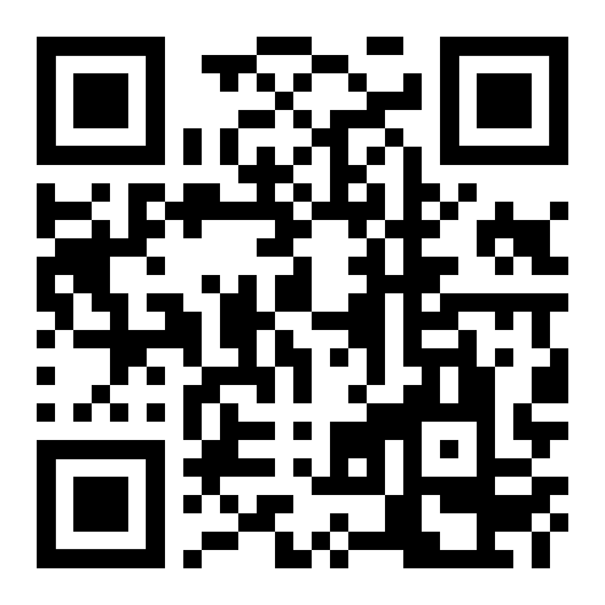
Wrapping Up
Try PowerShell / PowerCLI
My Github Repo - https://github.com/butch7903/PowerCLI
or:
Learn more about PowerCLI @
https://developer.vmware.com/powercli
VMware Hands on Lab (HOL) for PowerCLI:
https://labs.hol.vmware.com/HOL/catalogs/lab/10318

Slide 50
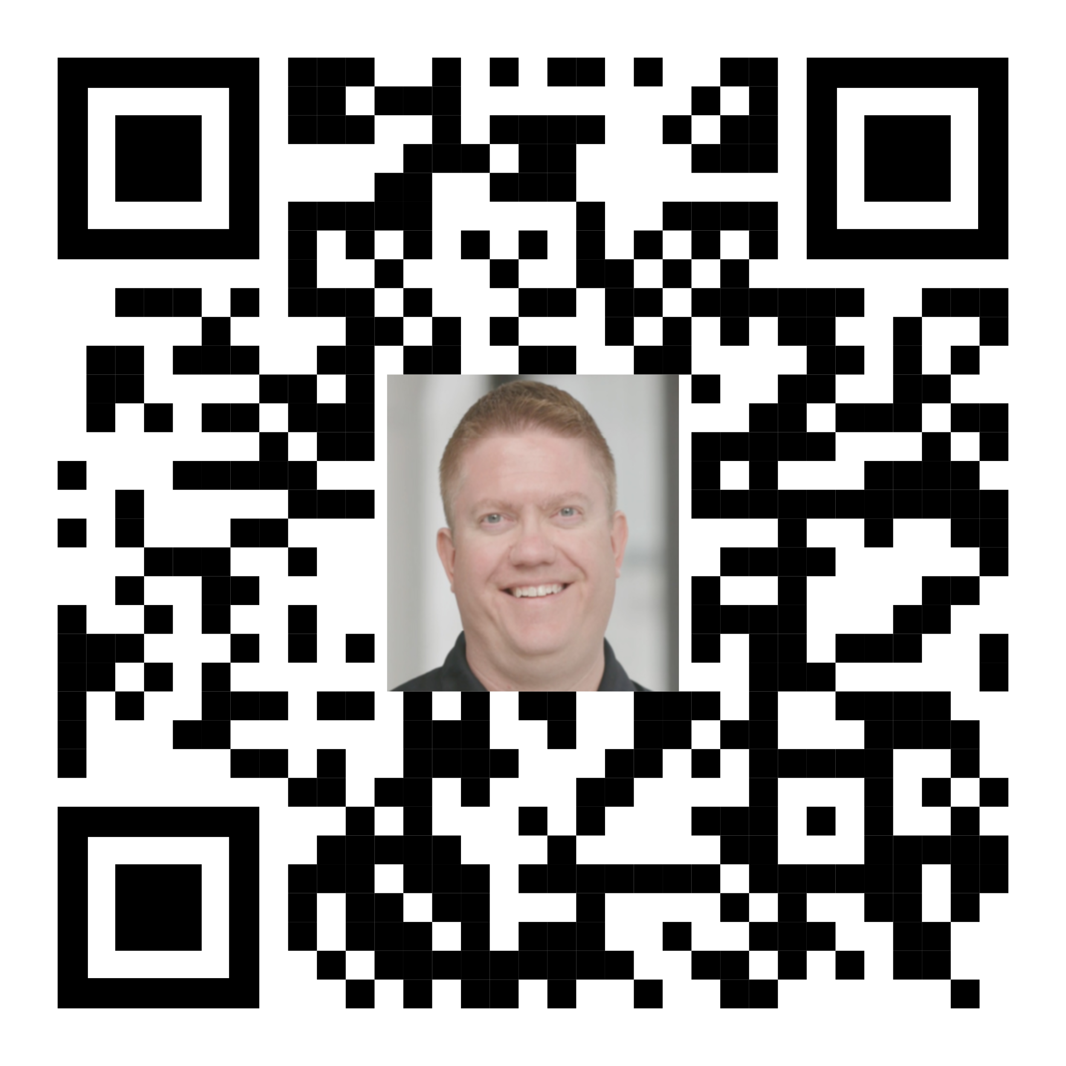



Thank You
Russell Hamker
VMware Enterprise Architect
https://linktr.ee/russellhamker
https://github.com/butch7903 https://github.com/guarddog-dev
Twitter: @butch7903 https://twitter.com/butch7903
LinkedIn: https://www.linkedin.com/in/russhamker/
Session# PowerCLI

Slide 51
Thank You

Slide 52
HEVC Codec for Presentation
Demo playback requires HEVC Codecs
To install:
Windows:
Via PowerShell: start ms-windows-store://pdp/?ProductId=9n4wgh0z6vhq
Install free codec pack for HEVC
MAC:
https://download.divx.com/stable/divx/DivXInstaller.dmg
Install dmg file

